Slide 1
CS 355/555
Probability and Statistics for Computer Scientists
Baocheng Geng
Lecture 23, 03/21/2025
CS 355/555Probability and Statistics for Computer Scientists

Slide 2

Table of Contents
Joint PDF
CS 355/555Probability and Statistics for Computer Scientists

Slide 3
Copyright Statement
Copyright Statement
Materials prepared for and/or included in this course are protected by copyright law. They are intended to be used only by students enrolled in this course during the current term and should not be further disseminated without prior permission from the course instructor.
CS 355/555Probability and Statistics for Computer Scientists

Slide 4
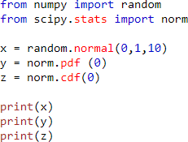
The Standard Normal in Python
Generate random variables
Compute the PDF and CDF of the standard normal distribution
CS 355/555Probability and Statistics for Computer Scientists

Slide 5
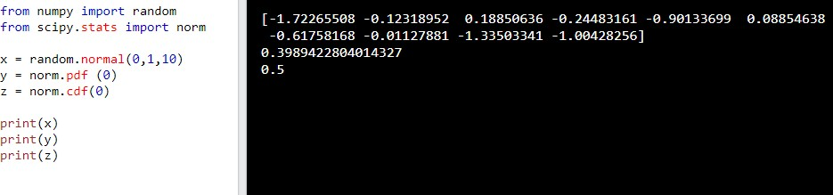
The Standard Normal in Python
CS 355/555Probability and Statistics for Computer Scientists

Slide 6
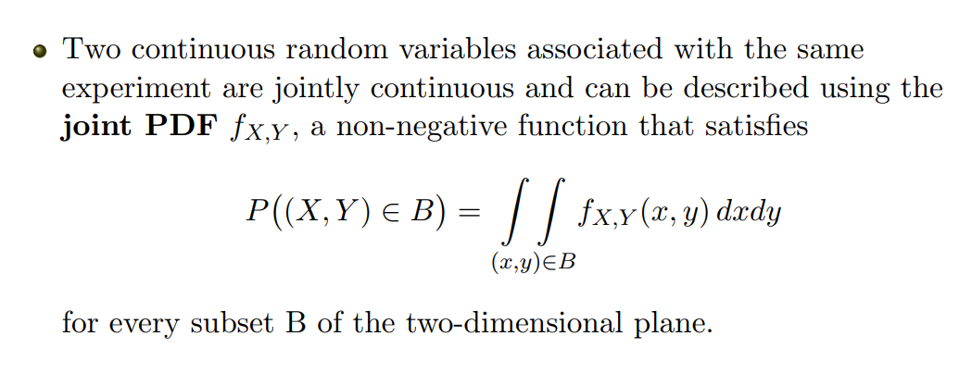
Joint PDF
CS 355/555Probability and Statistics for Computer Scientists

Slide 7
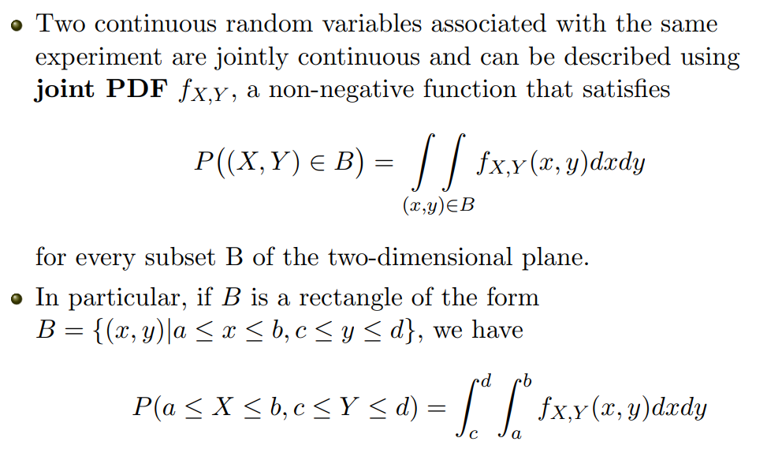
Joint PDF
CS 355/555Probability and Statistics for Computer Scientists

Slide 8
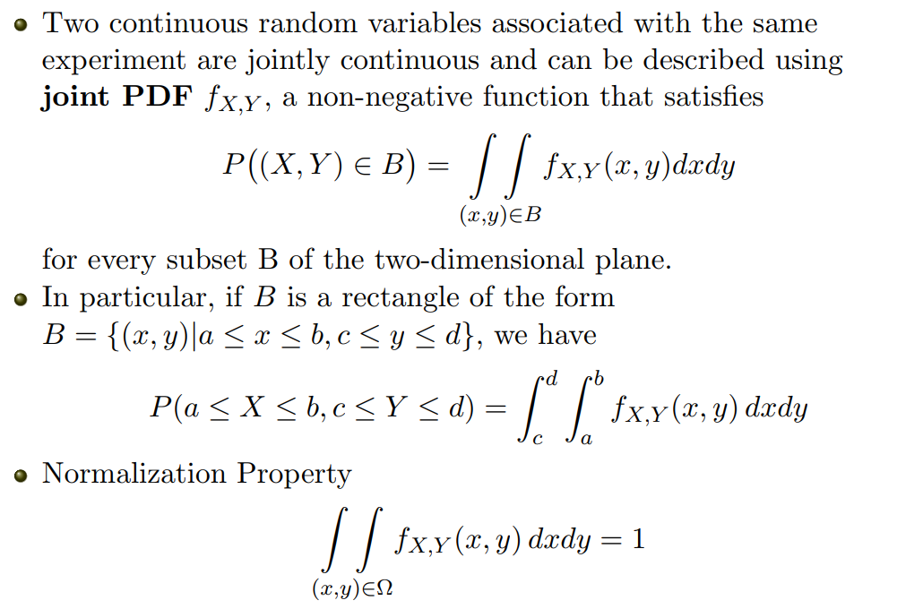
Joint PDF
CS 355/555Probability and Statistics for Computer Scientists

Slide 9
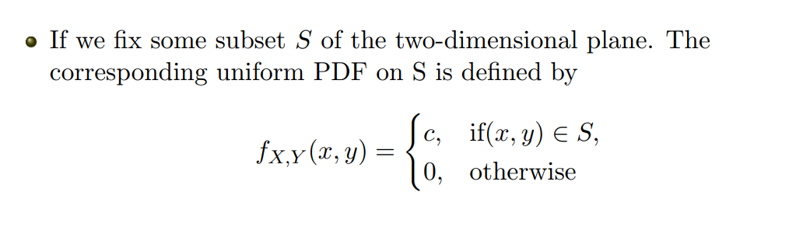
Uniform Joint PDF
CS 355/555Probability and Statistics for Computer Scientists

Slide 10
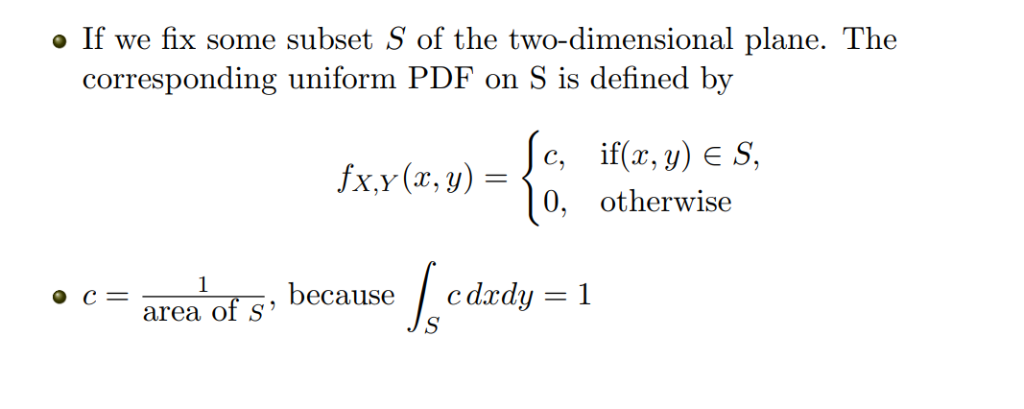
Uniform Joint PDF
CS 355/555Probability and Statistics for Computer Scientists

Slide 11
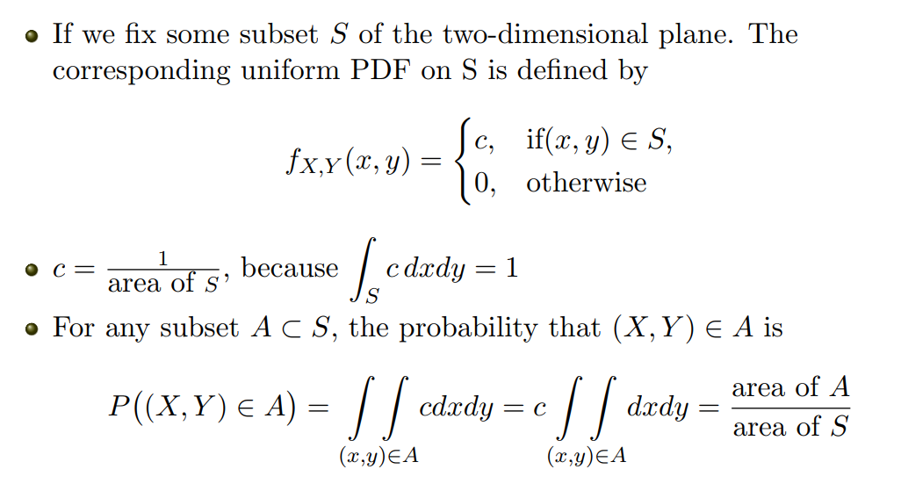
Uniform Joint PDF
CS 355/555Probability and Statistics for Computer Scientists

Slide 12
Example 3.10, pg 160
After class exercise
CS 355/555Probability and Statistics for Computer Scientists
12/1

Slide 13
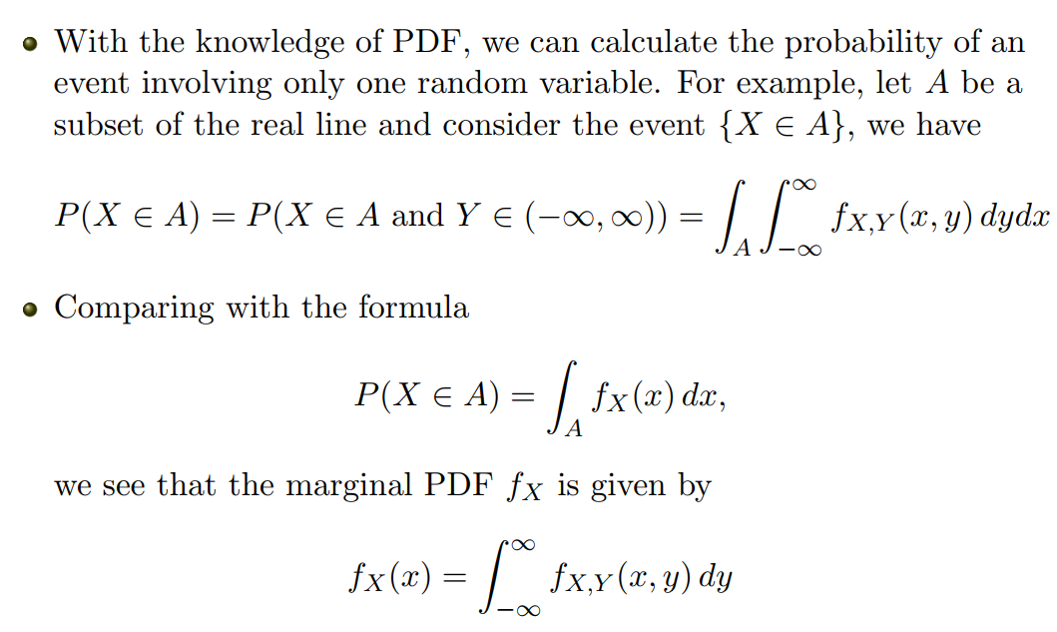
Marginal PDF
CS 355/555Probability and Statistics for Computer Scientists

Slide 14
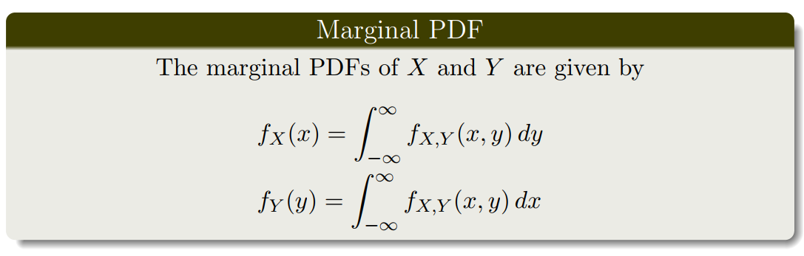
Marginal PDF
CS 355/555Probability and Statistics for Computer Scientists

Slide 15
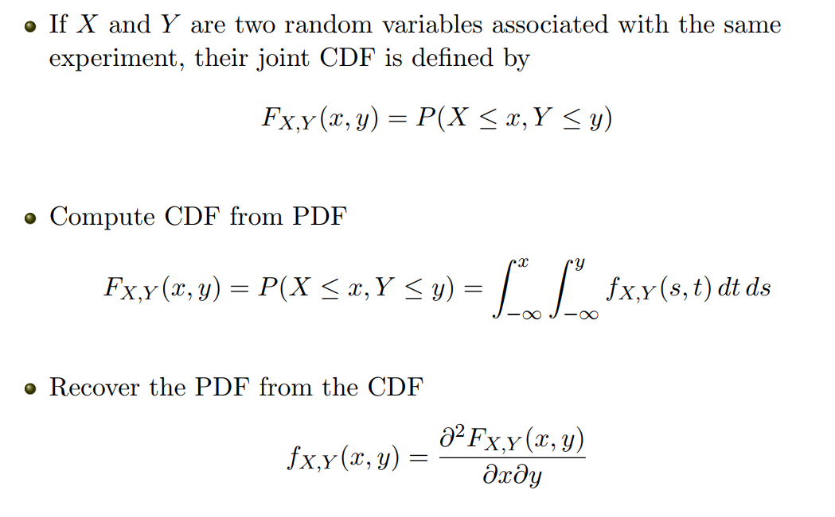
Joint CDF
CS 355/555Probability and Statistics for Computer Scientists

Slide 16
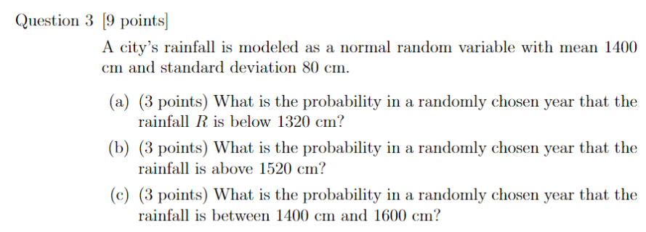
Quiz
CS 355/555Probability and Statistics for Computer Scientists

